Slide 1
Deconstructing the FUDD Chain: NIST Risk Management Framework (RMF)
Jennifer Kurtz, Cyber Program Director
jkurtz@manufacturersedge.com

Slide 2
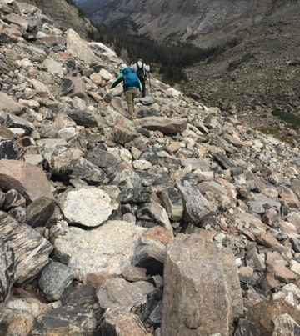
FUDD Chain Deconstruction: A Journey
Risk management stones
Fear
Uncertainty
Doubt
Disruption
Risk management tools
Route (framework)
Equipment
Team
Lessons learned
Discussion

Slide 3
RMF for Business Resilience
Cyber Security
Privacy
Physical Security
Contingency Planning & Disaster Recovery
Operational Security
Personnel Security
Product Security

Slide 4
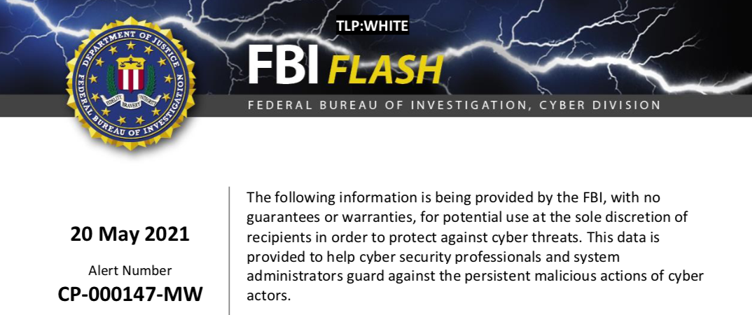
At least 16 Conti ransomware attacks targeting US healthcare and first responder networks
Steals files and encrypts servers and workstations
Online portal to pay demands
Stolen data sold or posted publicly if ransom unpaid
Recent demands as high as $25 million

Slide 5
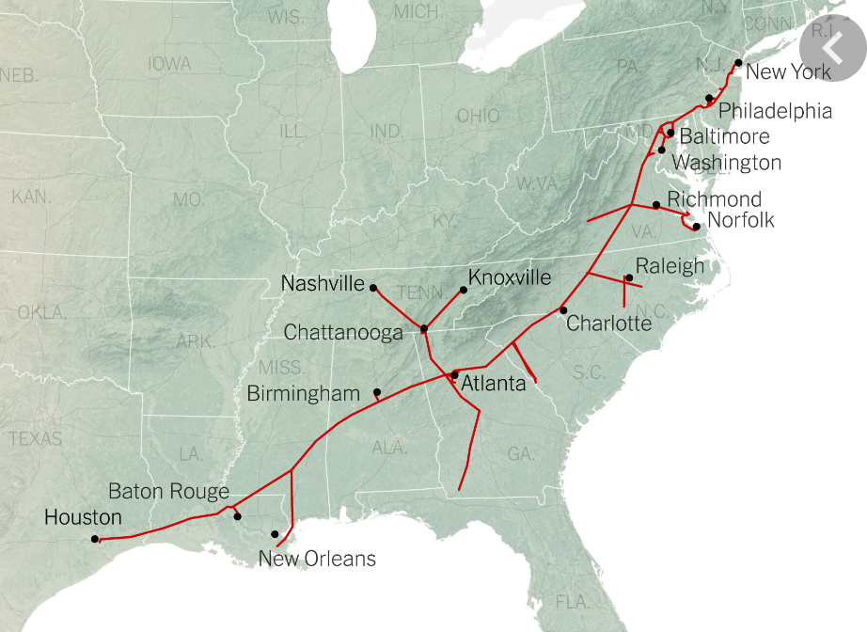
Prime, 5.5K-mile US pipeline
DarkSide
$4.4M ransom

Slide 6
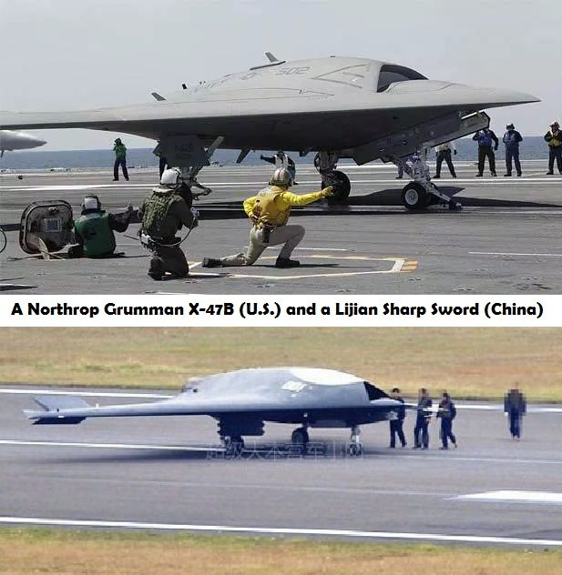
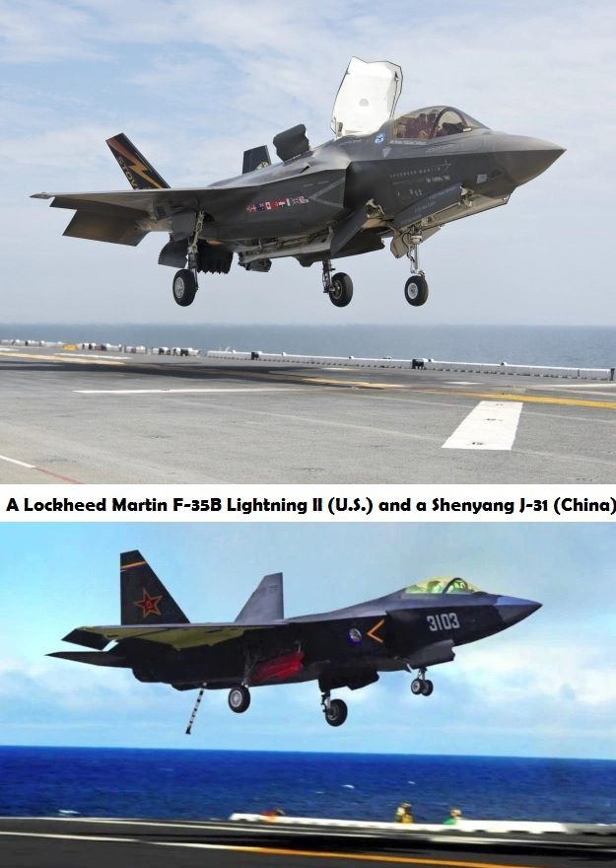
Intellectual Property Theft

Slide 7
Incident Response Planning

Slide 8
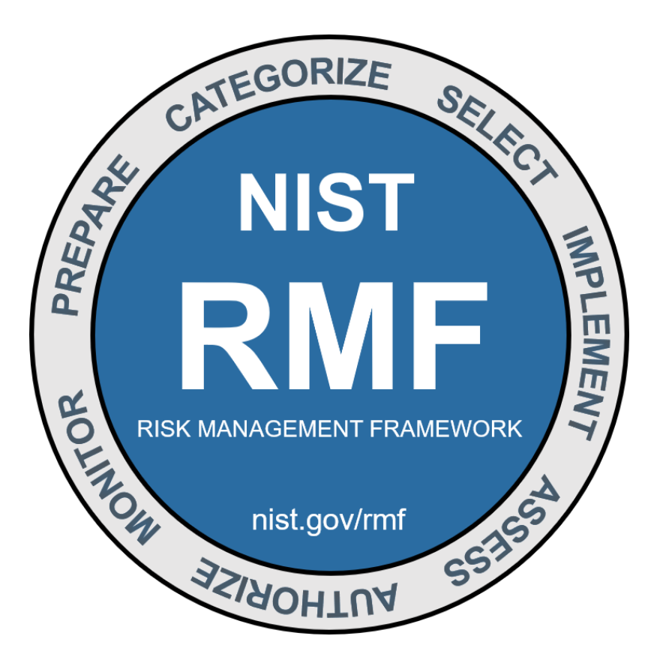
NIST Risk Management Framework (RMF)

Slide 9
RMF Steps: Route, Tools, Equipment
Prepare
Categorize
Select
Implement
Assess
Authorize
Monitor
Repeat

Slide 10
RMF Step 1: Prepare
Reduce complexity: focus attention
Organizational objectives
Resource allocation economy (e.g., common controls)
Critical asset prioritization
Align stakeholders
Organizational communication
Roles and responsibilities

Slide 11
RMF Step 2: Categorize
Inventory system characteristics
Name, purpose, expected useful life
Incident response points of contact
Dependencies (network/process topology)
Perform business impact analysis
Threat environment
Loss/compromise cost
Functional impact
Information impact
Recoverability impact

Slide 12
RMF Step 3: Select
Articulate organizational risk culture
Paranoid, prudent, permissive, promiscuous
Perplexed and/or paralyzed?
Define safeguards and countermeasures
Common controls
Physical and environmental protection, personnel security controls, incident response controls
System-specific controls
Identification and authentication, trust zones
Hybrid controls
Training and awareness

Slide 13
RMF Step 4: Implement
Evaluate control options
Direct costs
Purchase, support, maintenance
Indirect costs
Productivity/system performance overhead
Choose implementation approach
Examples

Slide 14
RMF Step 5: Assess
Ensure RM controls are in place and producing the desired outcomes
Provide decision-makers with information needed
Use internal and external assessors
Similar to quality process (e.g., ISO)

Slide 15
RMF Step 6: Authorize
Perform risk analysis and determination
Organizational risk tolerance
Dependencies among systems and control
Mission and business requirements
Criticality of the mission or business functions supported by the system
Overall risk management strategy of the organization
Approve or revise

Slide 16
RMF Step 7: Monitor
Build situational awareness
Key metrics
Anomaly detection
Trigger incident response activities
Adverse event classification as event or incident
Containment
Recovery
Reporting

Slide 17
Equipment
NIST Small Business Cybersecurity Corner
https://www.nist.gov/itl/smallbusinesscyber
Planning guides
Technology how-to notes
Federal partners (e.g., FTC, FCC, SBA, FBI, Infragard)
Response/recovery
NCSA case studies
Online training links
http://nvlpubs.nist.gov/nistpubs/ir/2016/NIST.IR.7621r1.pdf
Notes:
NCSA = National Cyber Security Alliance

Slide 18
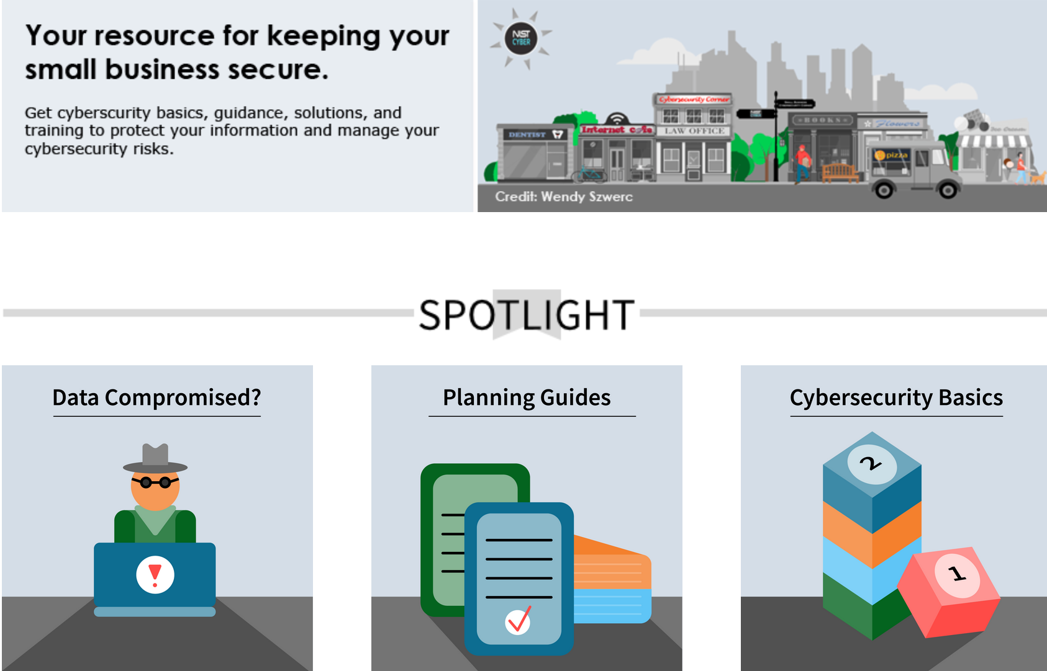
NIST Small Business Cybersecurity Corner
https://www.nist.gov/itl/smallbusinesscyber

Slide 19
Equipment (cont’d)
NIST reference material, for example
NIST SP 800-171r2 (for FAR and DFARS)
NIST HB 162 (guidebook, plans, policies)
NIST SP 800-160v2
MEP Connect (https://meis.nist.gov/_layouts/MEIS/Public/MepLogin.aspx)
ISO27k Forum sample policies/plans
www.ISO27001security.com
CMMC FAQs and CUI training
https://www.acq.osd.mil/cmmc/faq.html
https://securityhub.usalearning.gov/index.html
ISSA, ISACA, OWASP, SANS

Slide 20
Equipment (cont’d)
US Telecom Cybersecurity Toolkit
https://www.ustelecom.org/research/ustelecom-cybersecurity-toolkit-2/
Techno-speak
https://csrc.nist.gov/publications/detail/nistir/7298/rev-3/final
https://niccs.cisa.gov/about-niccs/cybersecurity-glossary
Information Security Forum (ISF) https://www.securityforum.org/research/threat-horizon-2019/
2020 Data Breach Investigations Report
2017 Identity Fraud Study, released by Javelin Strategy & Research
TrendMicro(and others) https://www.trendmicro.com/vinfo/us/security/news/cybercrime-and-digital-threats/business-email-compromise-bec-schemes

Slide 21
Equipment (cont’d)
Sample organizational “tools”
Employee cyber security awareness workshop
Risk management strategy roundtable
Inventory high-value business assets and processes
Security/risk control gap analysis and plan of action and milestones (POA&M or POAM)
System security plan (SSP) and security policy templates
Business continuity plan
Incident response plan
Cloud computing customer bill of rights
David Navetta (see MS Word document
https://www.pogowasright.org/cloud-computing-customers-bill-of-rights/

Slide 22
NIST Incident Response (IR) Life Cycle
SOURCE: NIST SP 800-61r2, “Computer Incident Handling Guide”
Notes:
https://nvlpubs.nist.gov/nistpubs/SpecialPublications/NIST.SP.800-61r2.pdf

Slide 24
Functional Impact Categories
SOURCE: NIST SP 800-61r2, “Computer Incident Handling Guide”

Slide 25
Information Impact Categories
SOURCE: NIST SP 800-61r2, “Computer Incident Handling Guide”

Slide 26
Recoverability Categories
SOURCE: NIST SP 800-61r2, “Computer Incident Handling Guide”
Notes:
Consider also PACE: primary, alternate, contingent, emergency
Consider recovery point objective (RPO) and recovery time objective (RTO)

Slide 27
NIST Tabletop Exercise (TTX) Definition
“A discussion-based exercise where personnel with roles and responsibilities in a particular IT plan meet in a classroom setting or in breakout groups to validate the content of the plan by discussing their roles during an emergency and their responses to a particular emergency situation. A facilitator initiates the discussion by presenting a scenario and asking questions based on the scenario.”
Source: <https://csrc.nist.gov/glossary>

Slide 28
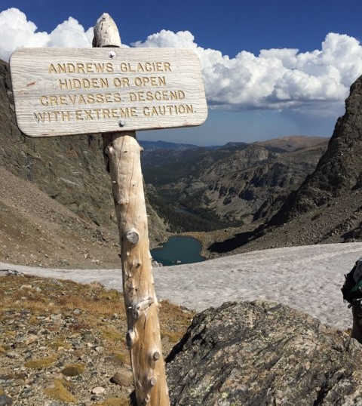
Deconstructing FUDD: A Team Sport
Follow a route
Lend a hand
Ask for help
Share stories
Keep trekking
Good luck!!!

Slide 29
Thank you for your time!
Discussion

